Slide 1
Breast Cancer Patient Information
By: Ashwill Daniels
Date: 13/09/2022

Slide 2
Data
This is a dataset about breast cancer patients. Please see the appendix for further explanation.

Slide 3
Objective
My goal is to look at various statistics like age, ethnicity and tumor size and display it through charts and numbers.

Slide 4
Statistics
Number of patients: 4024
Status: 3408 Survivors and 616 Deceased

Slide 5
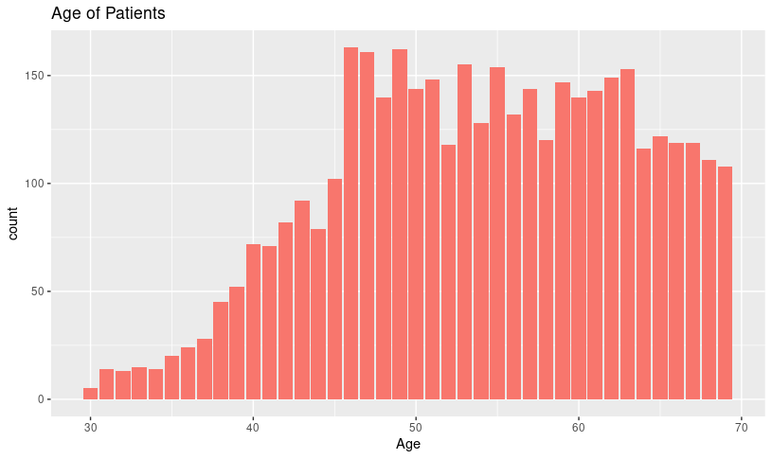
Age
Average age: 54

Slide 6
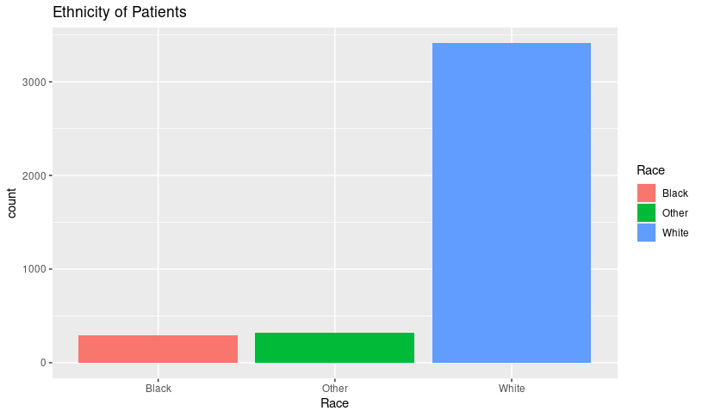
Ethnicity
White: 3414
Black: 291
Other: 320

Slide 7
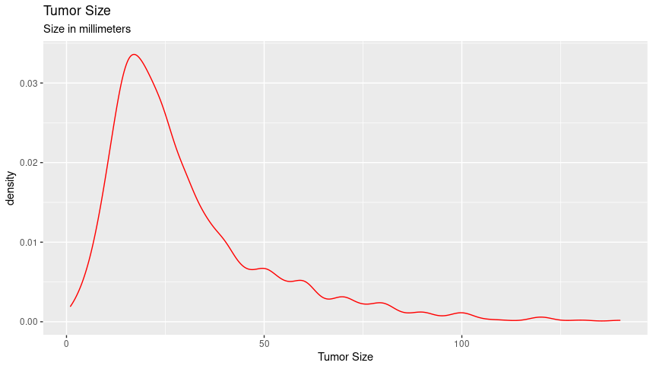
Tumor size
Average size: 30.47mm

Slide 8
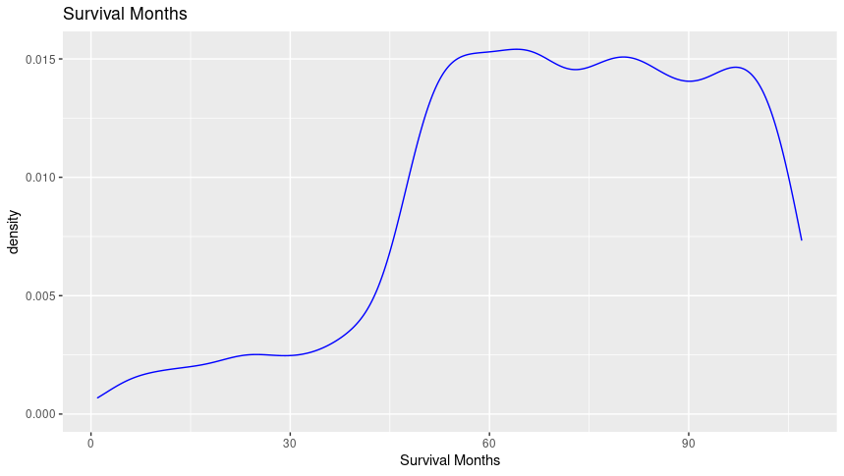
Survival Months
Average: 71 Months

Slide 9
Appendix 1
Data:
This dataset is from Kaggle.com. https://www.kaggle.com/datasets/reihanenamdari/breast-cancer
Made available by: Rihanna Namdari
Description: “This dataset of breast cancer patients was obtained from the 2017 November update of the SEER Program of the NCI, which provides information on population-based cancer statistics. The dataset involved female patients with infiltrating duct and lobular carcinoma breast cancer (SEER primary cites recode NOS histology codes 8522/3) diagnosed in 2006-2010.”

Slide 10
Appendix 2
Tools used: RStudio Cloud and Google Slides

